Slide 1




Industry Project Presentation
Augmented Reality Integration for Enhanced Automotive Diagnostics
By: Isha Gohil (20162101020)

Slide 2

Agenda Overview
1
Introduction
7
Implementation Details
2
Objectives
8
Conculsion
3
Expected Outcomes
4
Tools & Technologies
5
Methodology ( Modules )
6
Application Flowchart

Slide 3
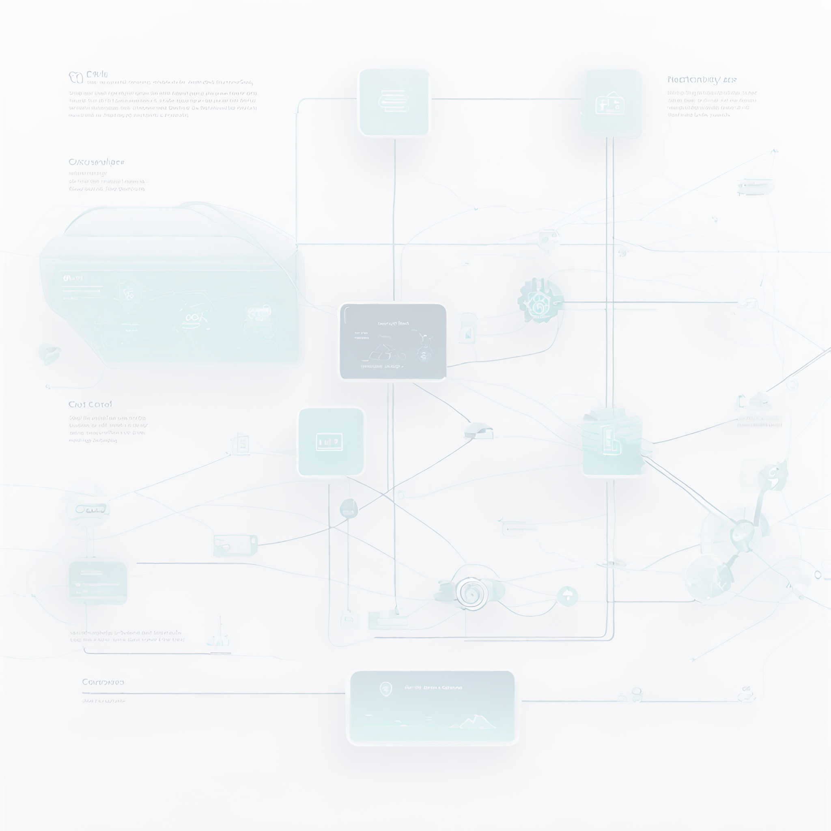


Introduction
Fixed Technologies is renowned for its innovative solutions in the automotive sector, especially through the use of augmented reality and advanced diagnostics. They focus on developing technologies like the Model Target Augmentation, which overlays digital information on real-world views for various applications including training and sales enhancements. Their products and services aim to simplify complex automotive processes, ensuring their partners are well-equipped to handle the evolving automotive landscape​

Slide 4
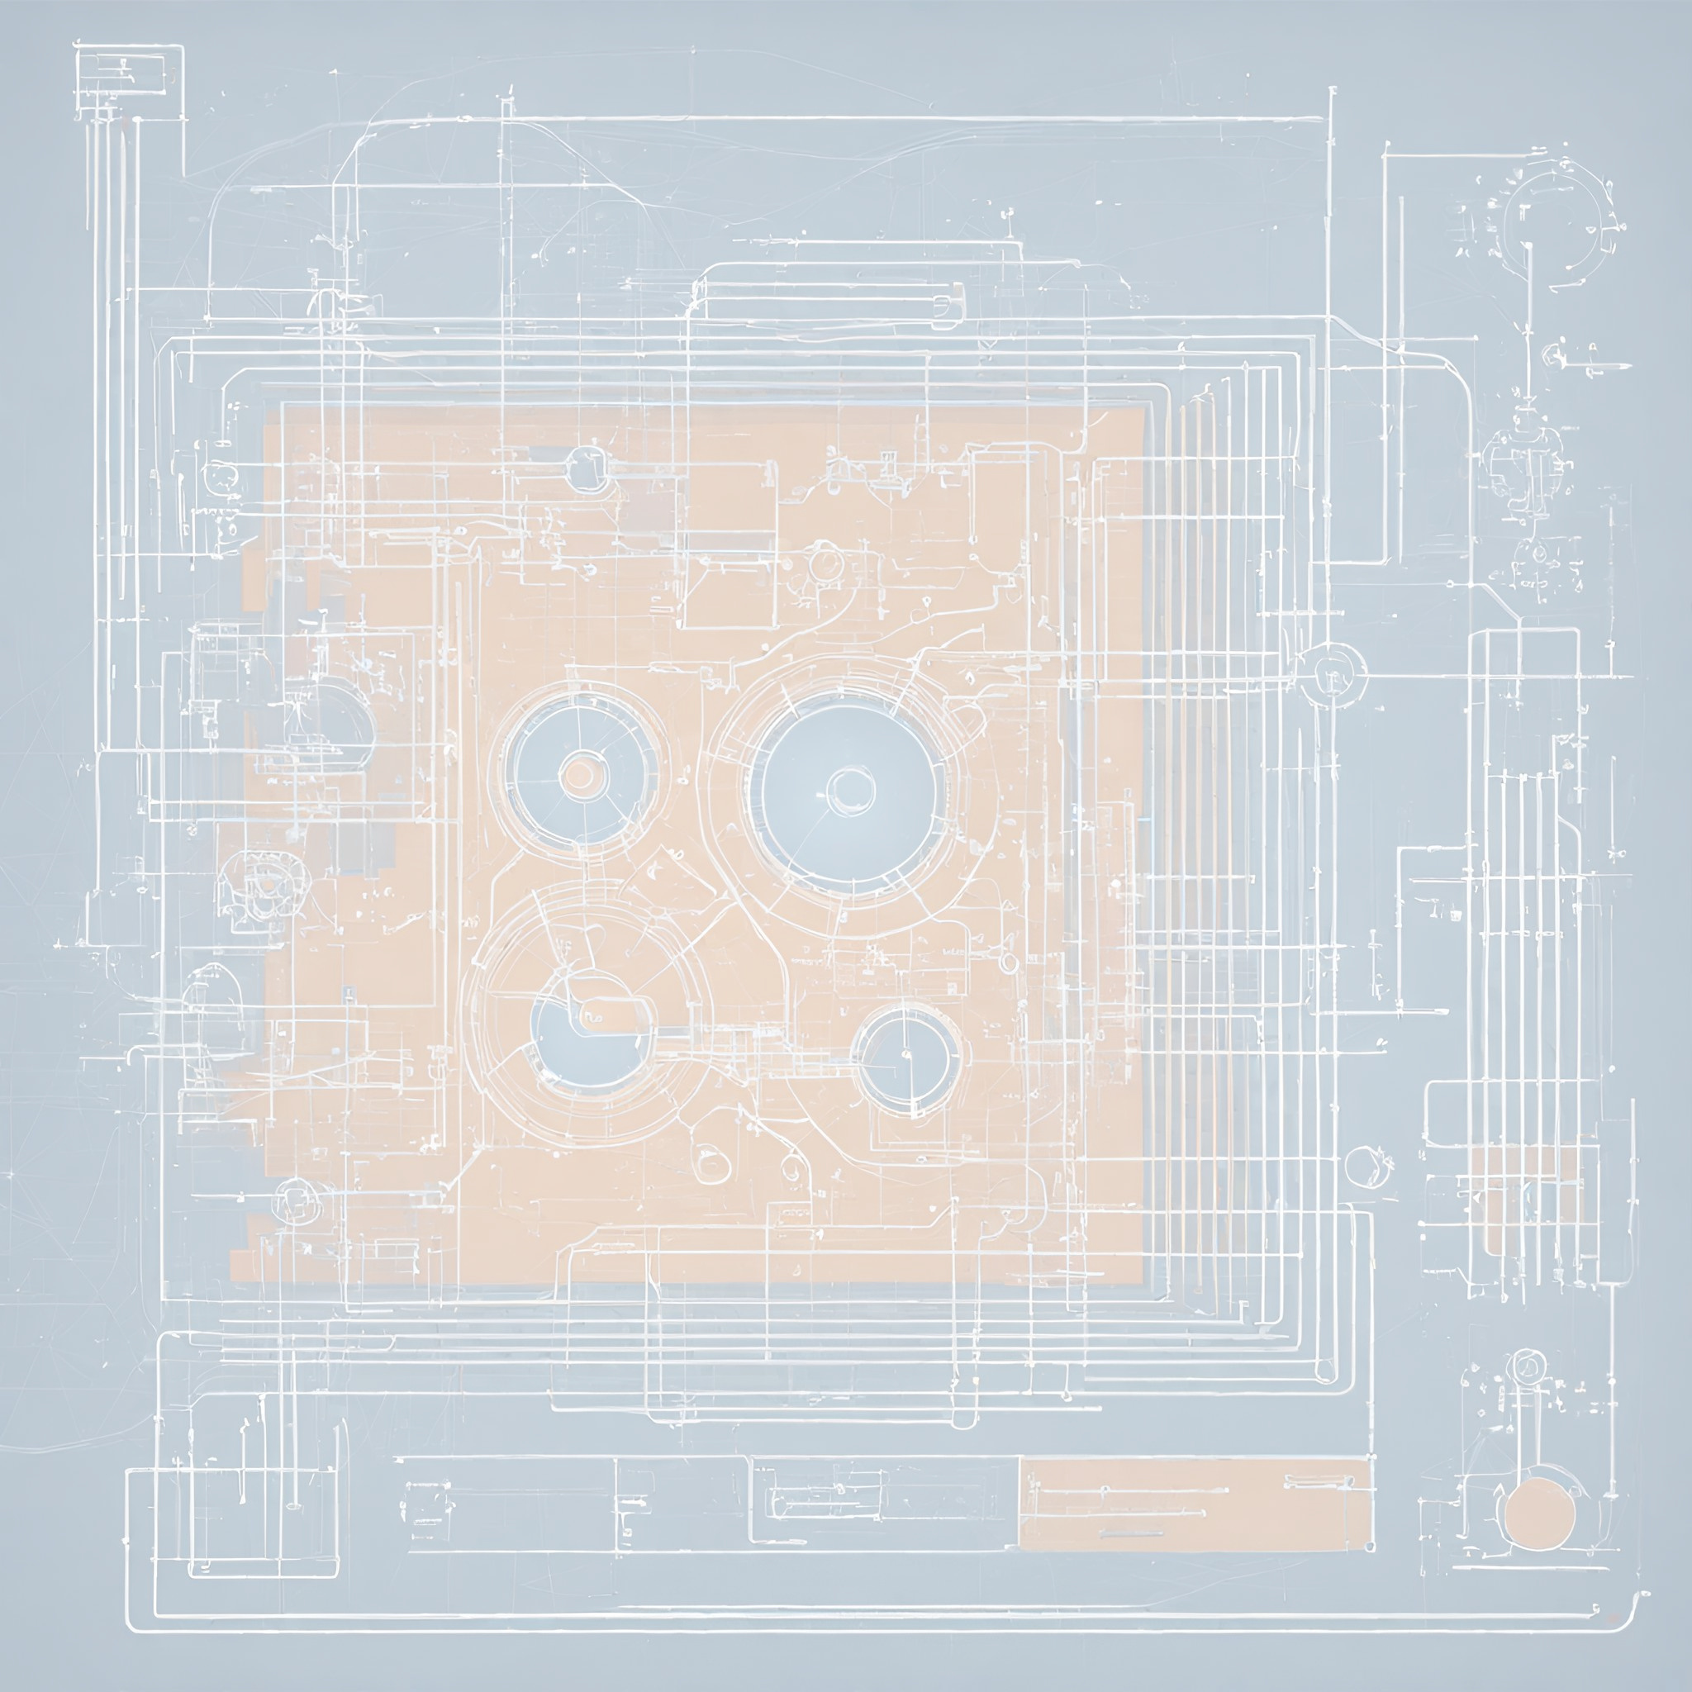









Objectives
Technical Objectives
Utilize Python for backend data processing and API handling.
Employ HTML, CSS, and JavaScript to build responsive front-end interfaces. C# for backend development of Augmented Reality.
Integrate ChartJS for dynamic and interactive data visualizations & Optimize user experience using Bootstrap for dashboard layouts.
Primary Objective
To develop and implement API adapters for integrating diverse software platforms, enhancing the connectivity between car dongles and automotive software.
Enhance technical skills in software development across multiple coding languages and frameworks.
Learning Objectives
Gain practical experience in handling real-world data integration challenges.
Develop problem-solving skills by working on complex, cross-platform integration.

Slide 5



Outcome
Enhanced integration of in-car dongles with automotive software via robust API adapters.
Improved data visualization on front-end dashboards leading to more intuitive user interfaces.
Streamlined diagnostics and troubleshooting processes through more efficient data handling.
Increased automation and accuracy in data analysis, reducing human error and operational delays.
Advanced proficiency in multiple programming languages and software tools.
Stronger problem-solving and project management skills through real-world application.

Slide 6
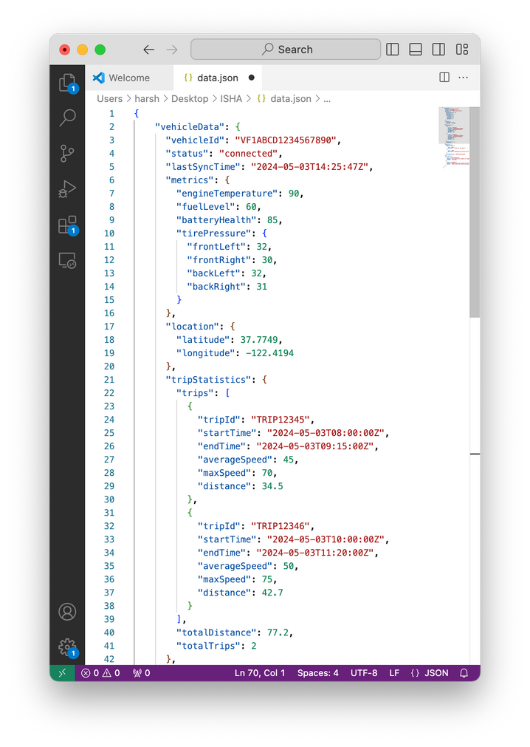
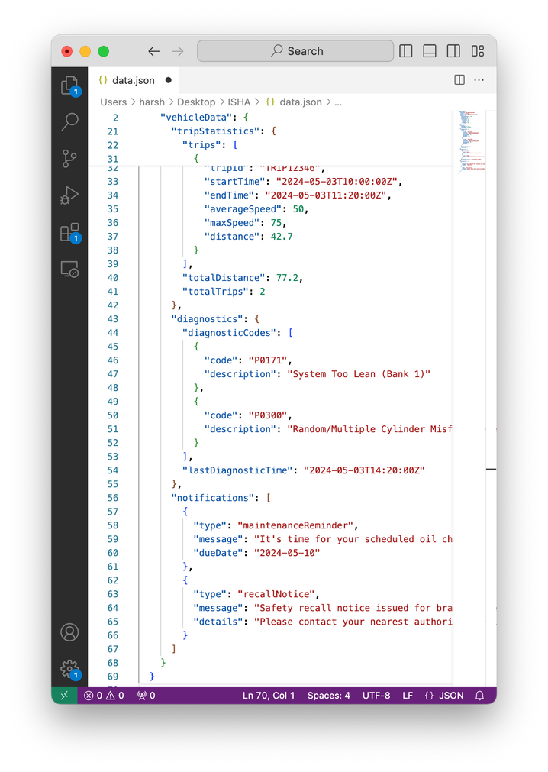
Outcome

Slide 7
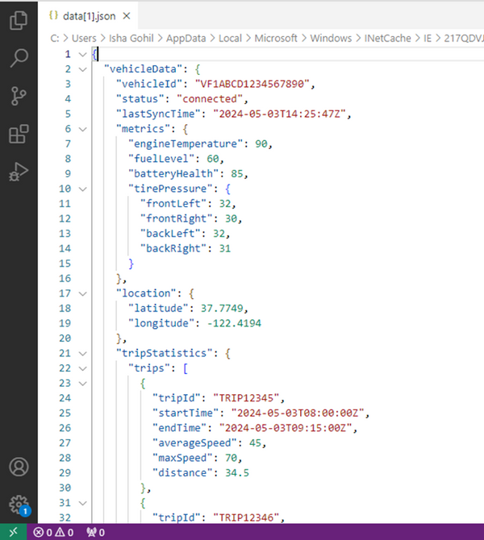
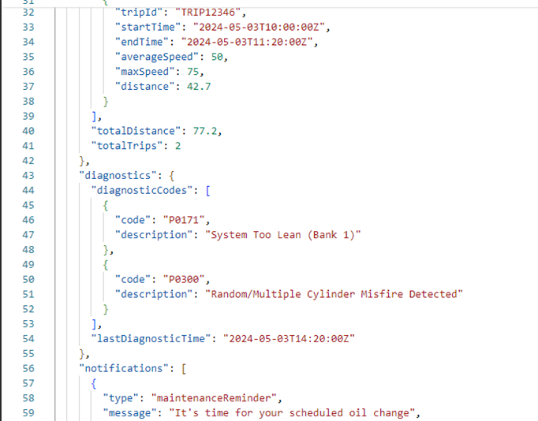
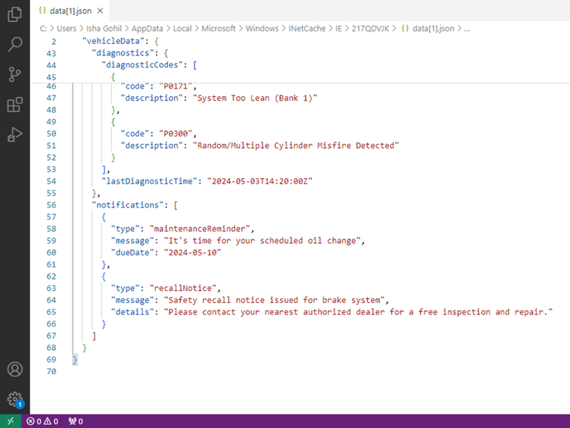
Outcome

Slide 8
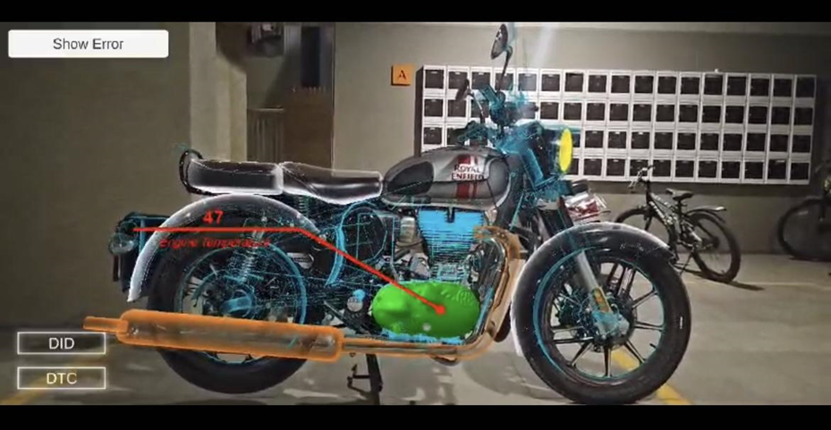
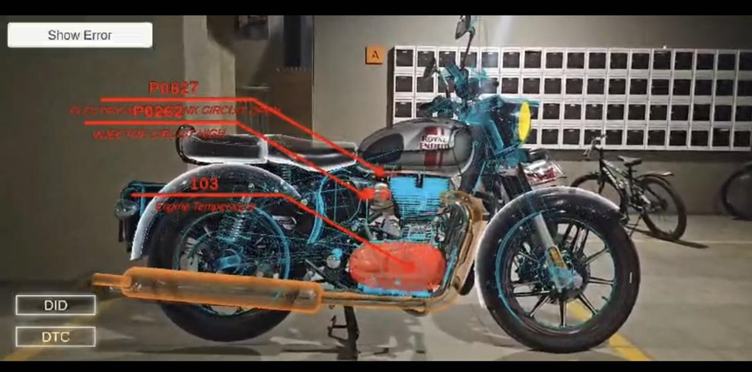
Outcome

Slide 9
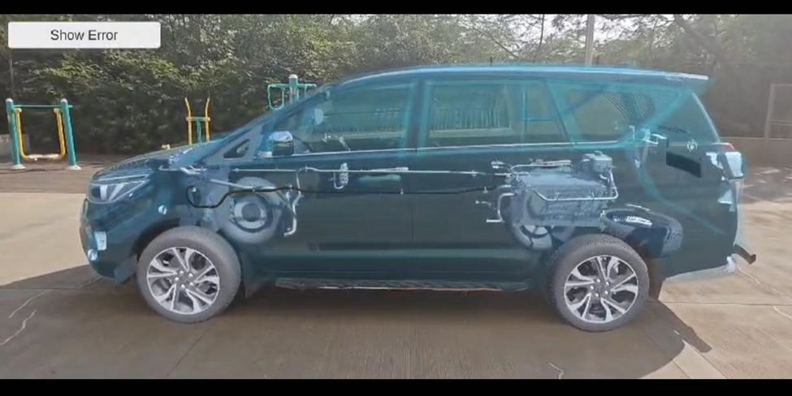
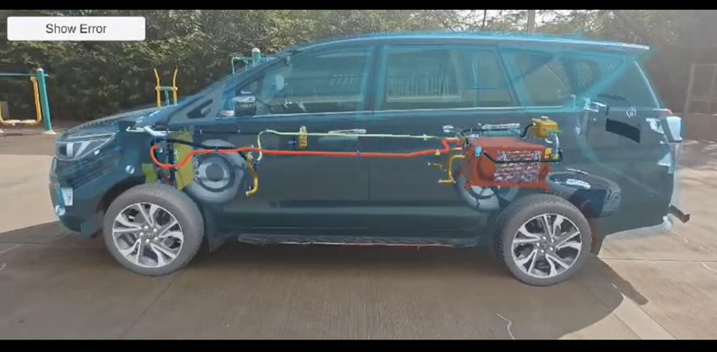
Outcome

Slide 10



Tools and Technologies
JavaScript
Python
Core programming for interactive elements.
Used for backend data handling and APIs.
HTML & CSS
C#
Employed for structuring and styling the frontend.
Used for backend development handling the output of AR.

Slide 11


01
API Development Module
Design and development of API adapters to ensure seamless communication between car dongles and manufacturer software.
02
Frontend Visualization Module
Use of HTML, CSS, and JavaScript to build the user interface.
Integration of ChartJS for dynamic data visualization.
Methodology
( Modules )
03
Testing and Optimization Module
Rigorous testing of APIs and frontend interfaces to ensure reliability and performance.
Continuous feedback loop with end users for iterative improvements.
04
Deployment and Monitoring Module
Deployment of the complete system in a production environment.
Ongoing monitoring and maintenance to handle any issues post-deployment.

Slide 12

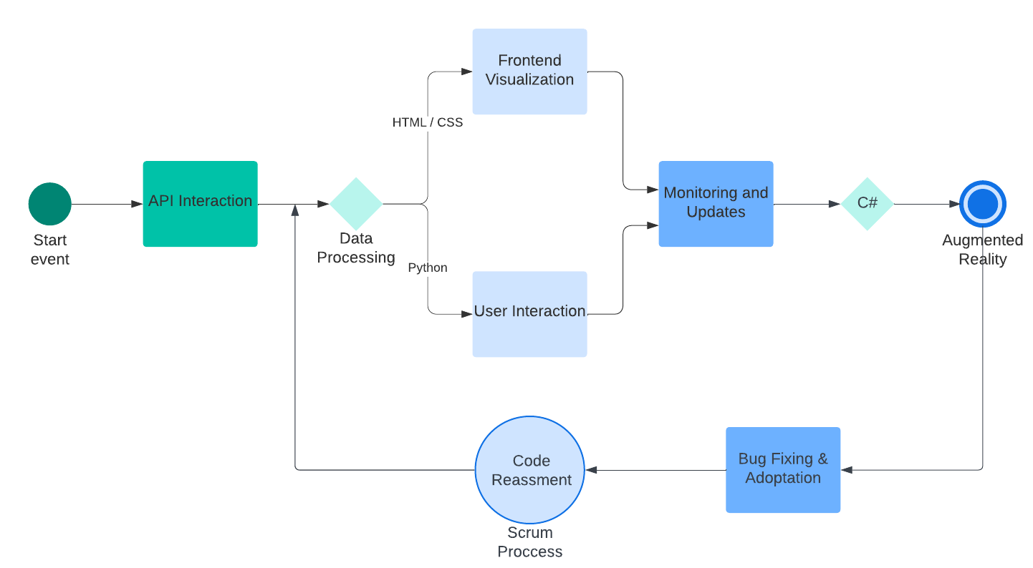
Application Flowchart

Slide 13

Implementation Details
01
02
03
04
API Development
Detail the process of designing API adapters, including the specific protocols and standards used.
Explain the testing and debugging practices employed to ensure API reliability and security.
Frontend Integration
Describe the methods used for integrating frontend technologies with backend APIs.
Highlight any challenges faced and how they were overcome.
Data Visualization
Discuss the tools and techniques used for visualizing data in real-time on the dashboard.
Provide examples of how data visualization improved user interaction and decision-making.
Deployment
Outline the deployment process, including any cloud services or server configurations used.
Mention the steps taken for monitoring and maintaining the system post-deployment.

Slide 14



Conclusion
In summary, during my internship at Fixed Technologies, I focused on developing and implementing API adapters aimed at bridging the gap between car dongles and automotive software. This initiative significantly improved data communication and frontend visualization within the automotive domain. Through this hands-on experience, I gained invaluable insights into cross-platform software integration while honing my technical proficiency across multiple programming languages and tools. Additionally, I contributed to the development of augmented reality applications using C#, further expanding my skill set and contributing to the company's innovative efforts in automotive technology solutions. Overall, this internship not only enhanced operational efficiencies but also laid the groundwork for continuous innovation within the automotive industry.

Slide 15



THANK
YOU
ishagohil20@gnu.ac.in
https://www.fixedtec.com/

